Slide 1
AWS Educate

Slide 2
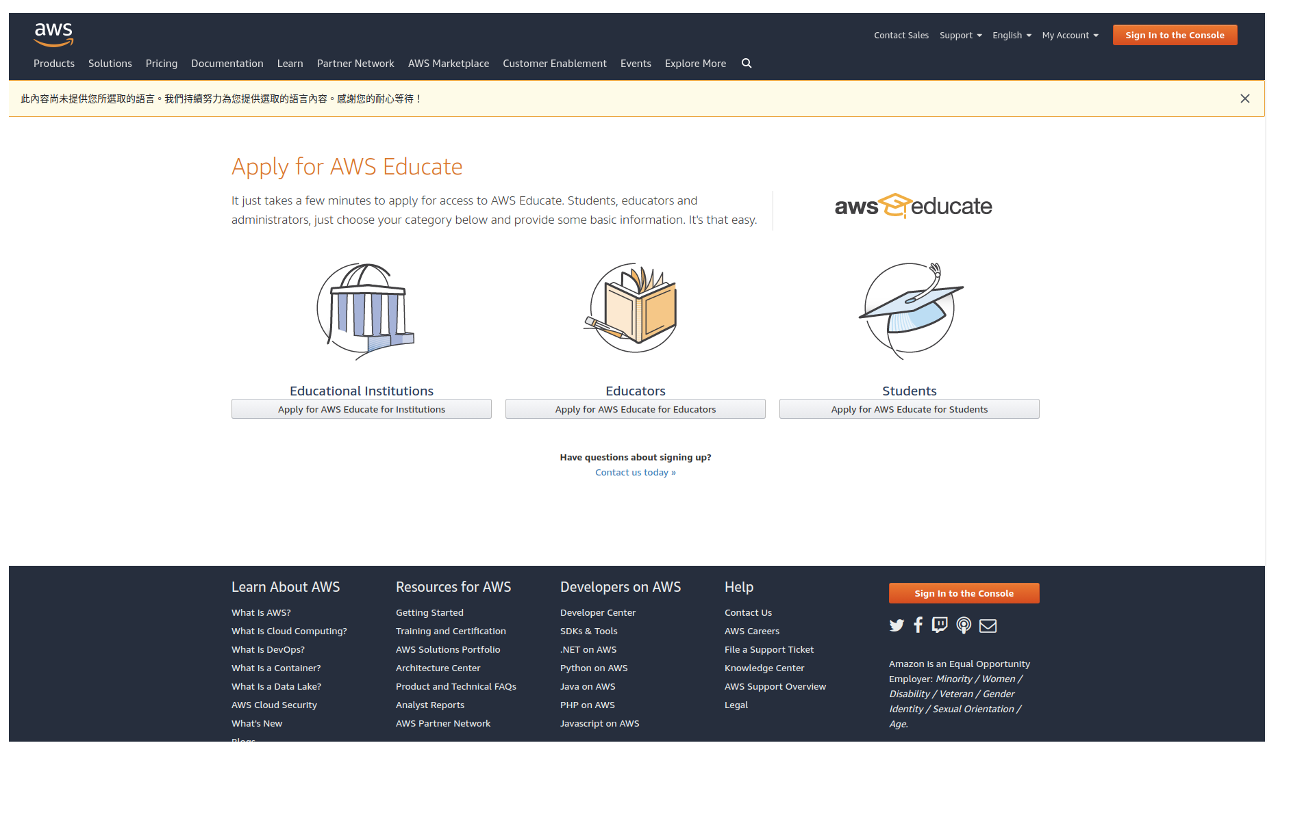
Step 1 - Go to https://aws.amazon.com/tw/education/awseducate/apply/

Slide 3
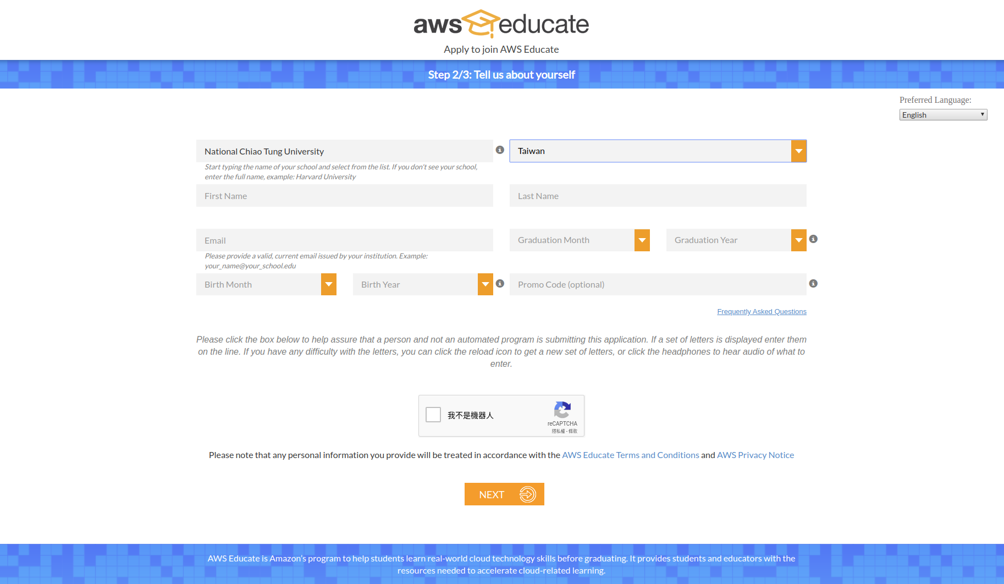
Step 2 - Fill out the form

Slide 4
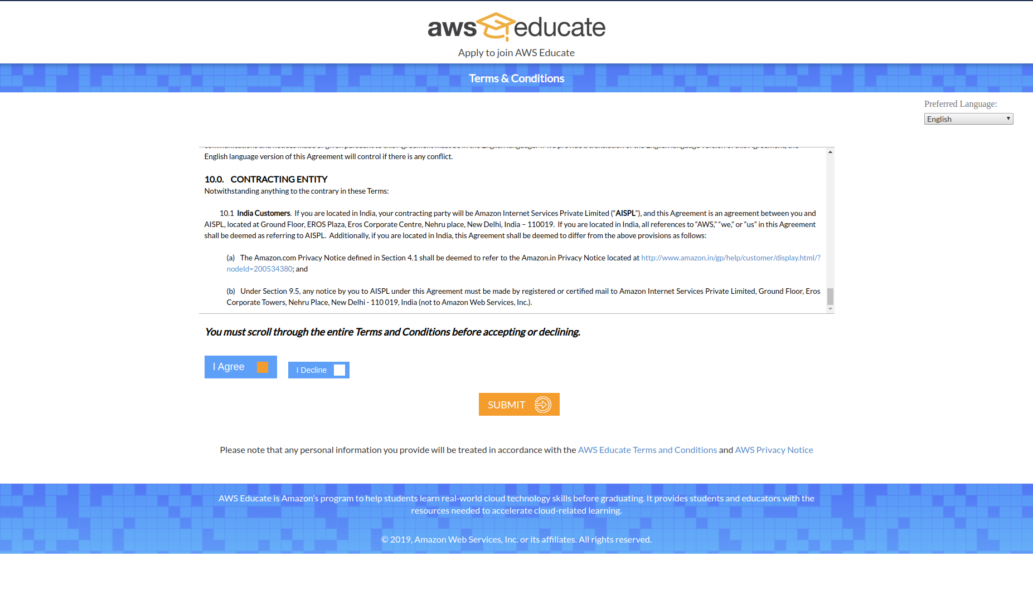
Step 3 - Agree Terms & Conditions

Slide 5
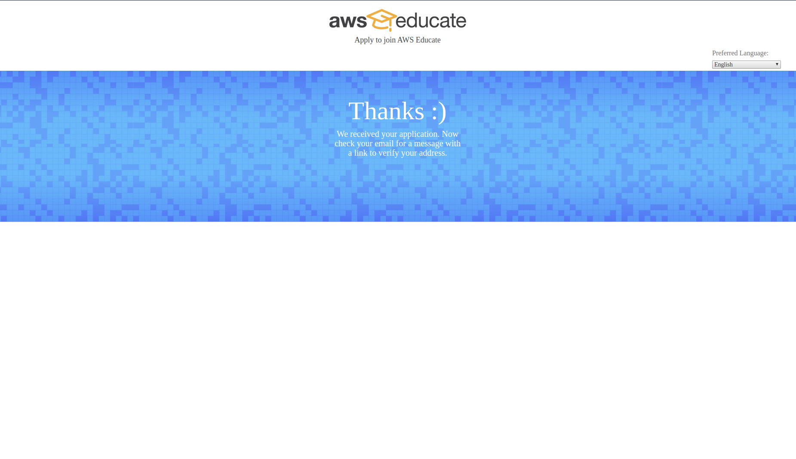
Step 4.1 - Wait for email verification

Slide 6
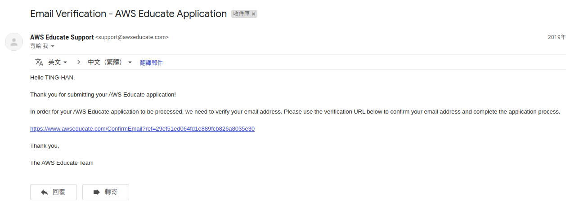
Step 4.2 - Email verification

Slide 7
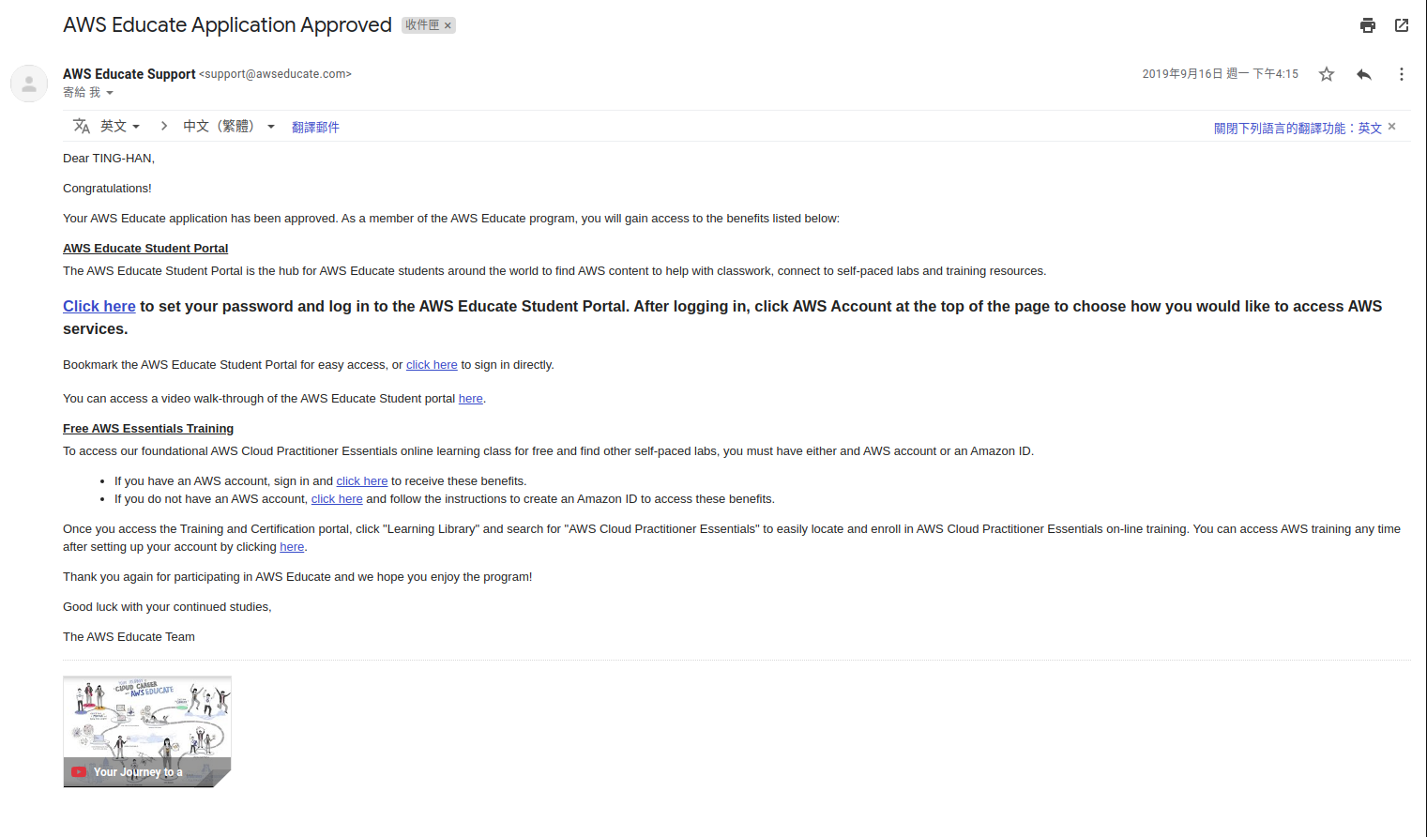
Step 4.3 - Application Approved

Slide 8
Step 5 - Tell us your AWS Educate email address
After application approved, please go to https://forms.gle/Wbvem94wFQfqJHUy5.
Fill out this google form, and we will invite you to join our AWS Educate Classroom.

Slide 9
TAs contact
鄭人豪 jenhao.cs08g@nctu.edu.tw
顏佳儀 happy1103.cs08g@nctu.edu.tw
林廷翰 thlin.cs08g@nctu.edu.tw
張城溥 paul851006@gmail.com
陳凱軒 tkaishien.cs08g@nctu.edu.tw

